Slide 1

CS 533 INTRO TO DATA SCIENCE
Michael Ekstrand

Slide 2
INSTANCES AND SAMPLING

Slide 3

Learning Outcomes
Identify the instances in a data set
Determine the correct level at which to sample for the bootstrap or test data
Bootstrap a CI for a linear regression’s coefficients
Photo by Mael BALLAND on Unsplash

Slide 4
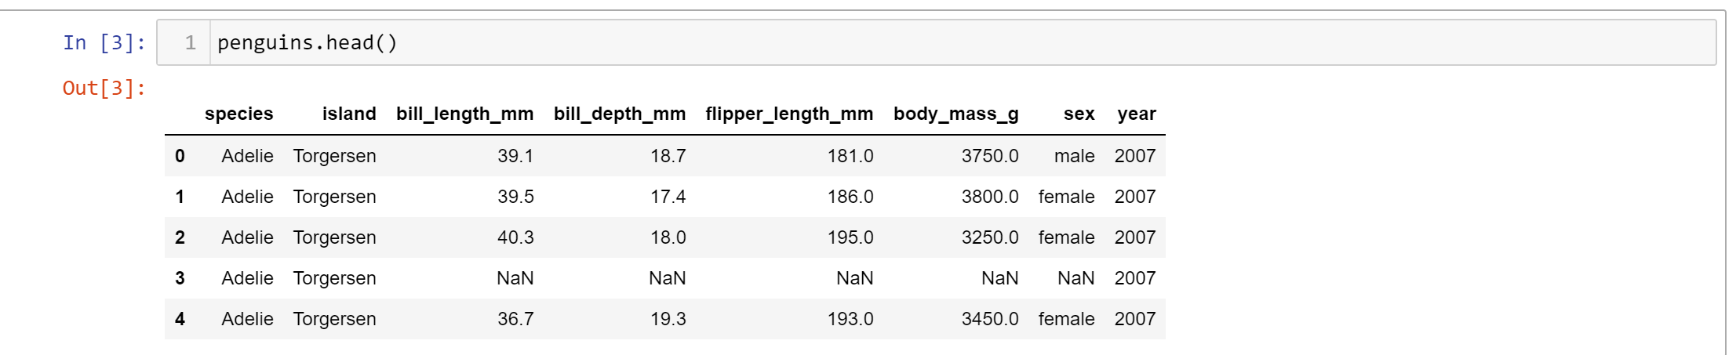
Instances
An observation of a single thing
Has one or more variables
The variable values go together – row 0 is one penguin
Covariance / correlation measure intra-instance relationships

Slide 5
Sampling
Goal: bootstrap a confidence interval for flipper/mass correlation
Sample: penguin instances
Each bootstrap sample has n of them
Compute: correlation coefficient
CI is 95% interval of the bootstrap sample correlation coefficient

Slide 6
Bootstrapping Linear Models
We can bootstrap any statistic
Say, a linear model coefficient!
Sample rows (penguin instances)
Fit the model to each sample
Extract statistic
Can do multiple statistics simultaneously

Slide 7
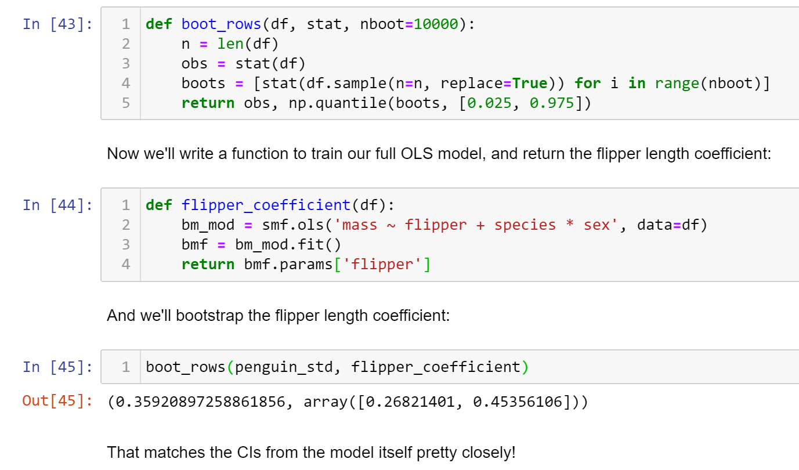
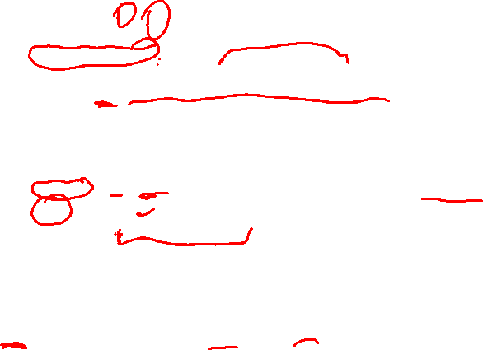
Bootstrap Code

Slide 8
Related Quantities
We often compute relationships between variables of an instance
Paired t-test
Correlation coefficient
Linear regression
Keep instances together is the common rule

Slide 9
Bootstrap Components
Two pieces to a bootstrap design:
Statistic(s) to compute
Sampling strategy
To bootstrap a CI, sample instances
For single-variable statistic, can just sample values
Sampling a variable & taking variable from sample are the same
Two or more variables – must sample instances to keep them together

Slide 10
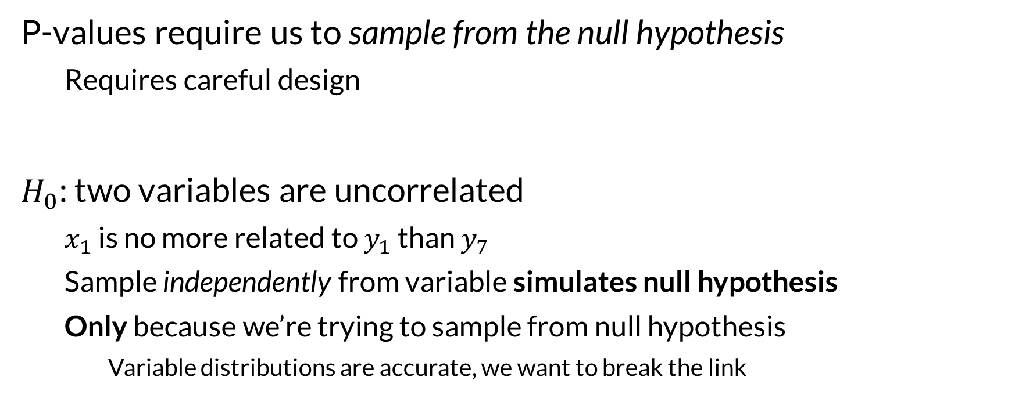
Bootstrapping P-values
P-values require us to sample from the null hypothesis
Requires careful design
$H_{0}$: two variables are uncorrelated
$x_{1}$ is no more related to $y_{1}$ than $y_{7}$
Sample independently from variable simulates null hypothesis
Only because we’re trying to sample from null hypothesis
Variable distributions are accurate, we want to break the link

Slide 11
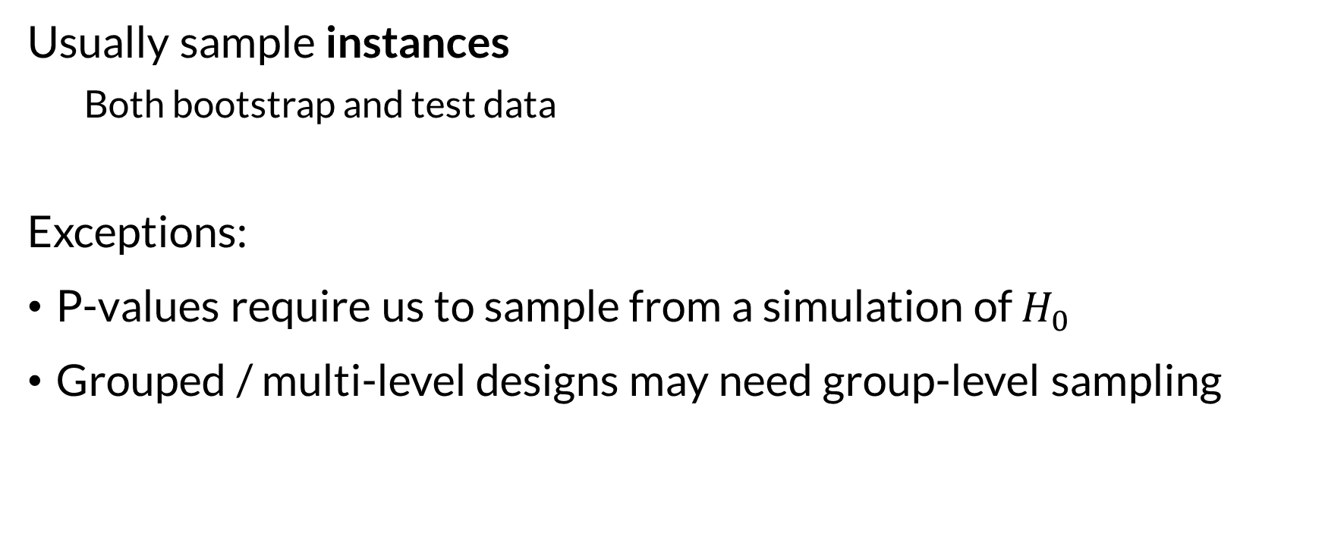
Sampling Review
Usually sample instances
Both bootstrap and test data
Exceptions:
P-values require us to sample from a simulation of $H_{0}$
Grouped / multi-level designs may need group-level sampling

Slide 12

Wrapping Up
A cleaned and ready-to-model data set consists of instances.
Most of our sampling procedures should sample instances.
Photo by Dušan S. on Unsplash

